Slide 2
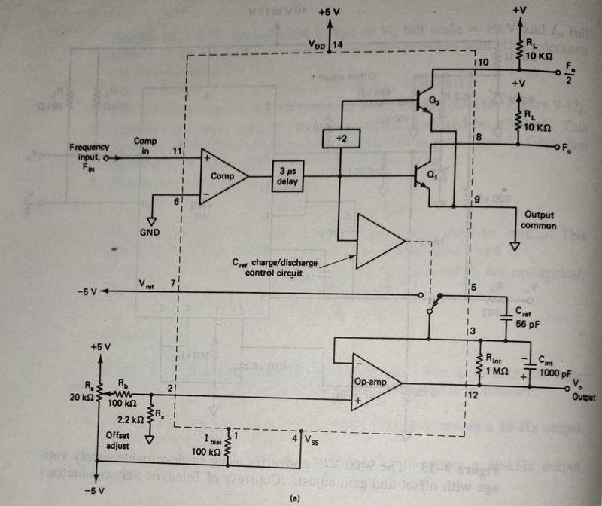
Figure 1. DC to 100 kHz F/V Converter

Slide 3
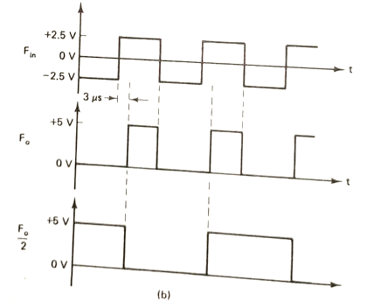
Figure 2. F/V Digital outputs

Slide 4
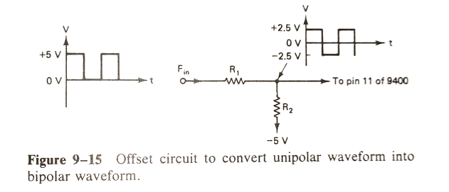
3.

Slide 5


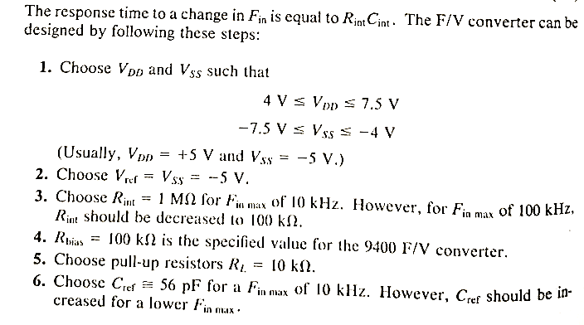

Slide 6


